Slide 1

WAY TO ENTERPRISE
AWS
VTI ACADEMY
Author: duy.nguyenngoc1@vti.com.vn

Slide 2
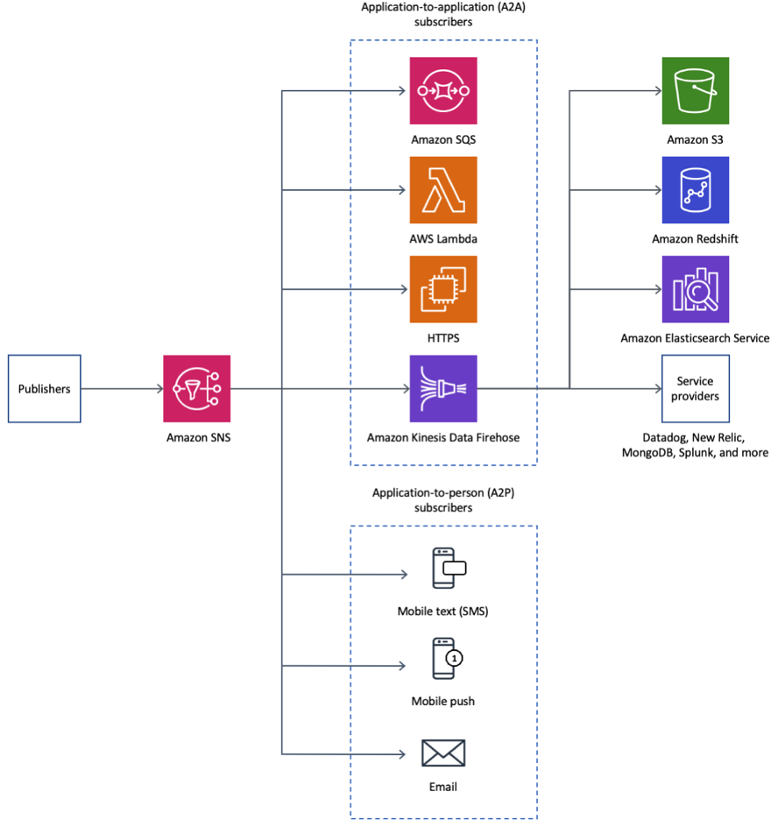
Simple Notification Service
A service that allows you to send notifications to subscribers (Ex: Email, SMS, …, other AWS Services)
Price: https://aws.amazon.com/sns/pricing
Tutorial: https://docs.aws.amazon.com/sns/latest/dg/welcome.html

Slide 3
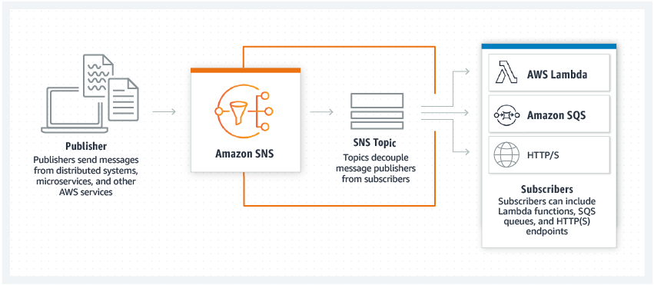
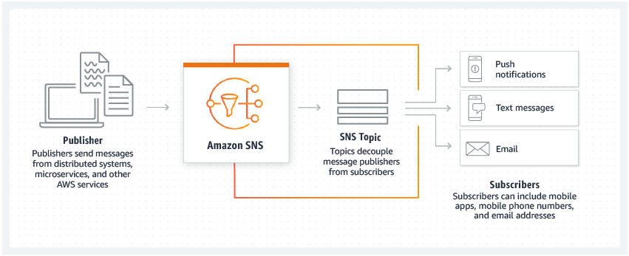
Simple Notification Service
Features
Application-to-application messaging (A2A)
Application-to-person notifications (A2P)

Slide 4
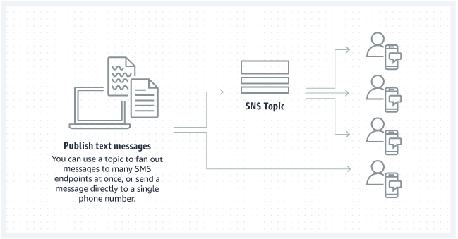
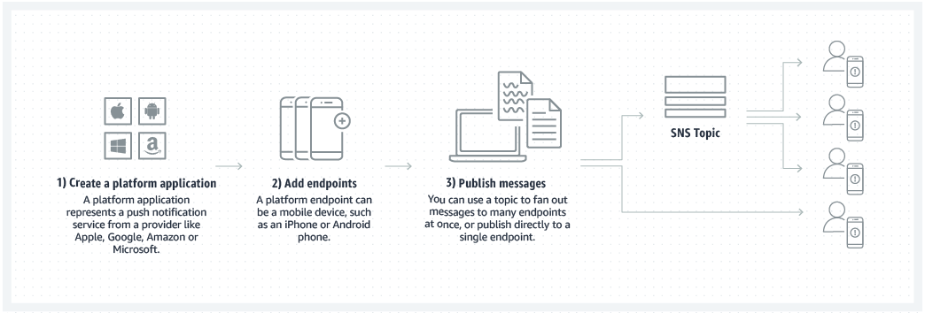
Simple Notification Service
Push Notification via
    Amazon device messaging (ADM)
    Apple IOS/MAC
    Baidu for Android
    Firebase cloud messaging(FCM)
    Windows 8+
Send SMS via sandbox

Slide 5
Simple Notification Service
Demo
  Create Topic
  Create Email Subscription
  Test Email Subscription
  Create SMS Subscription
  Create SQS Subscription
  Test SMS Subscription

Slide 6
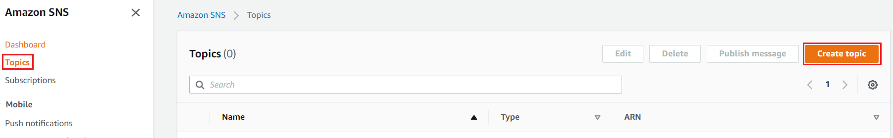
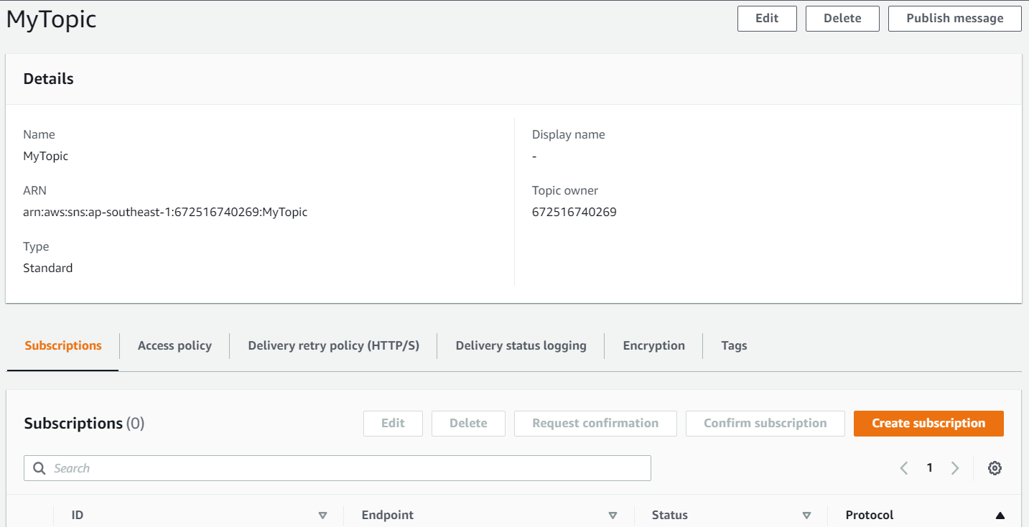
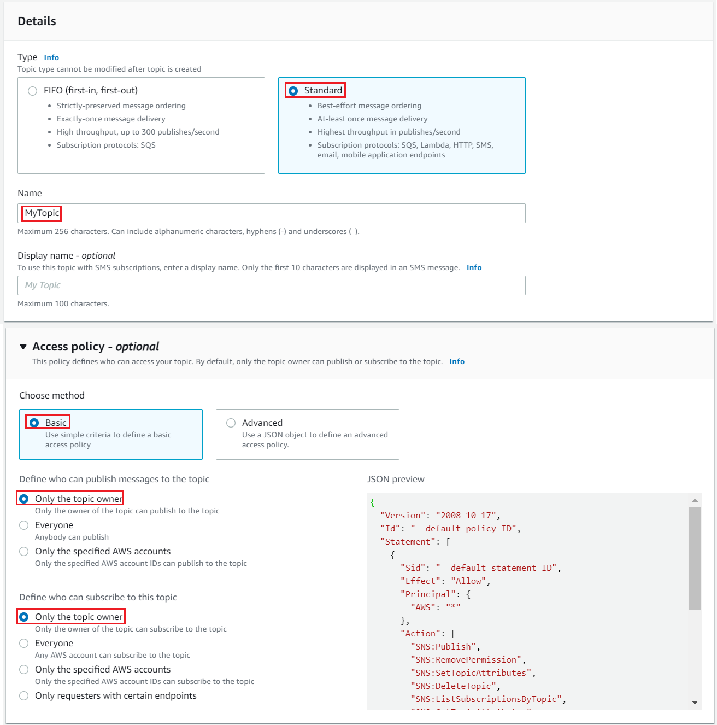
Simple Notification Service
  Create Topic
Create topic

Slide 7
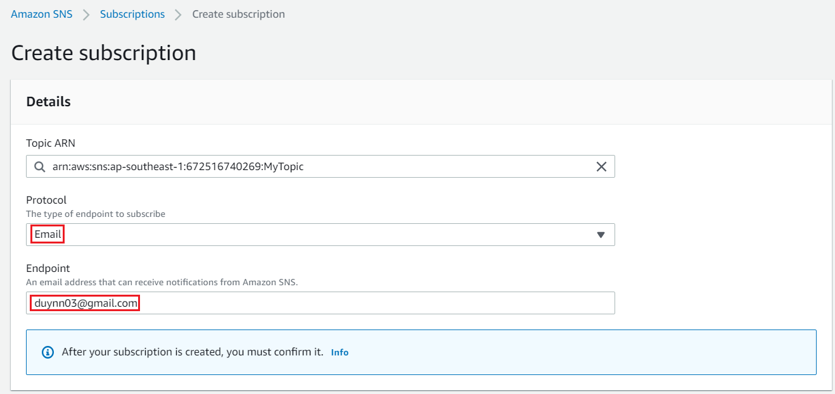
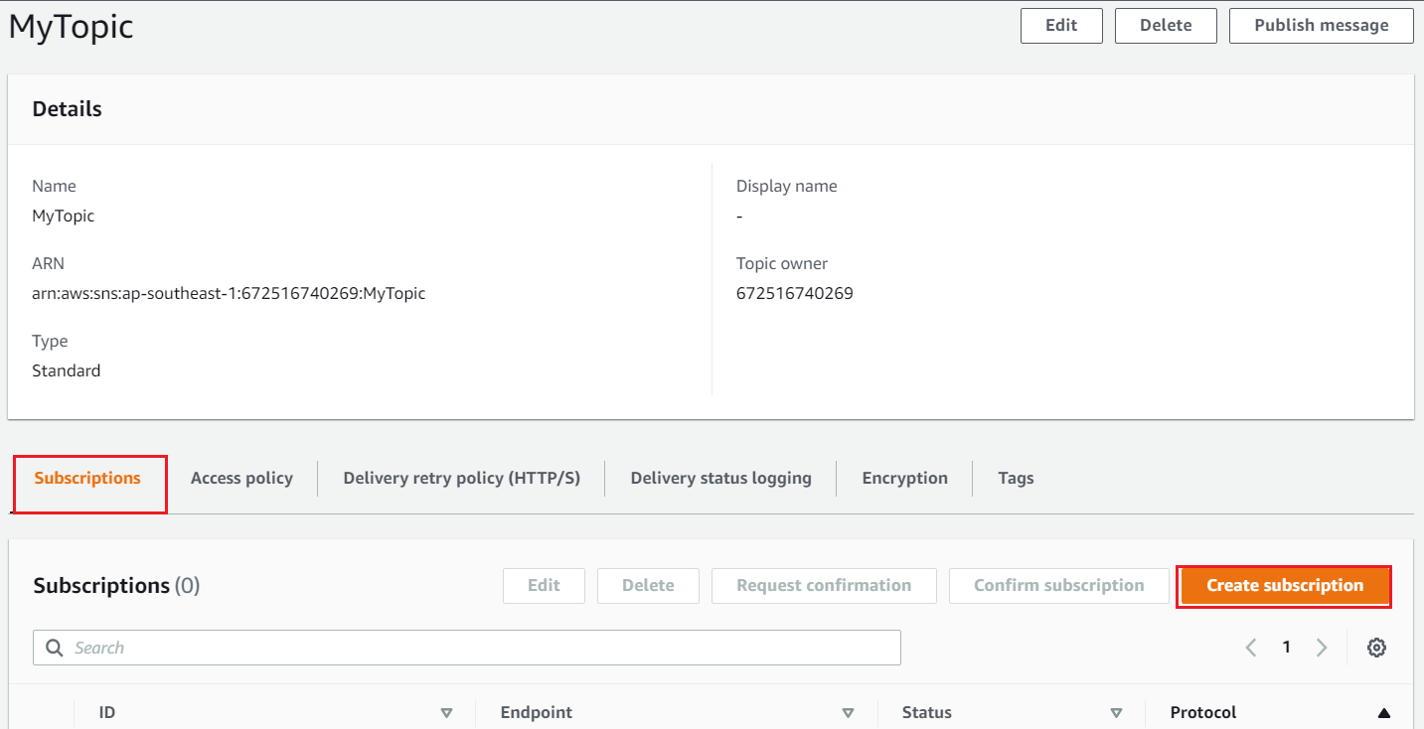
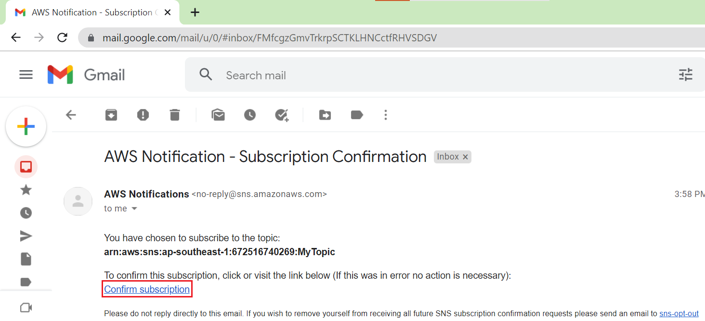
Simple Notification Service
  Create Email Subscription

Slide 8
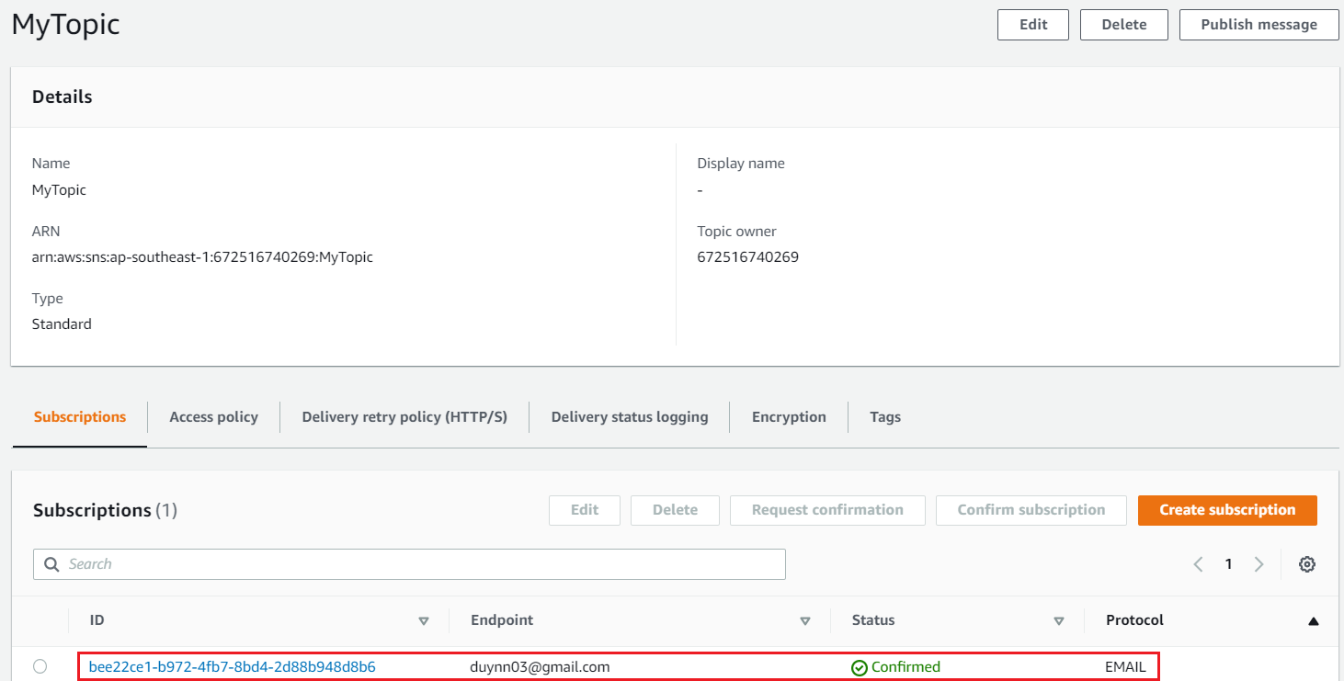
Simple Notification Service

Slide 9
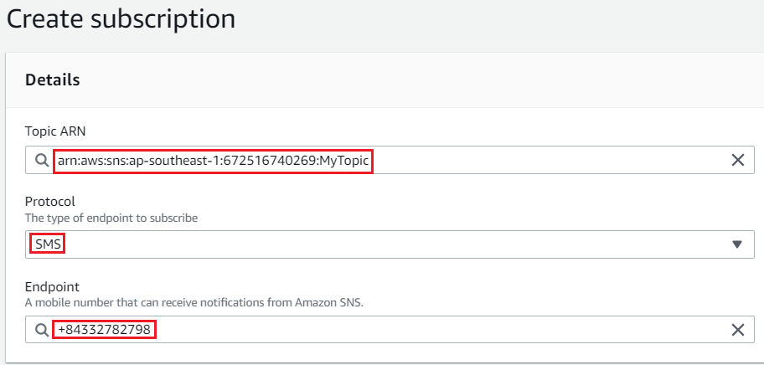
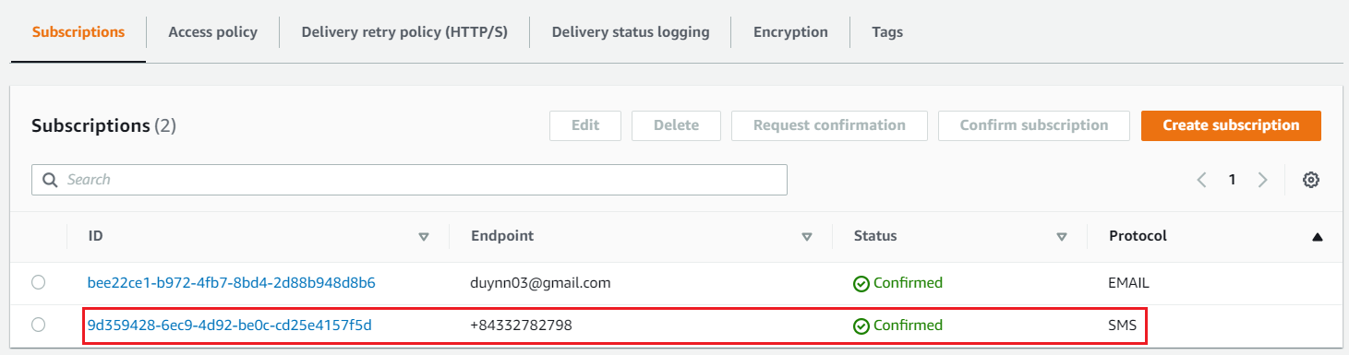
Simple Notification Service
  Create SMS Subscription

Slide 10
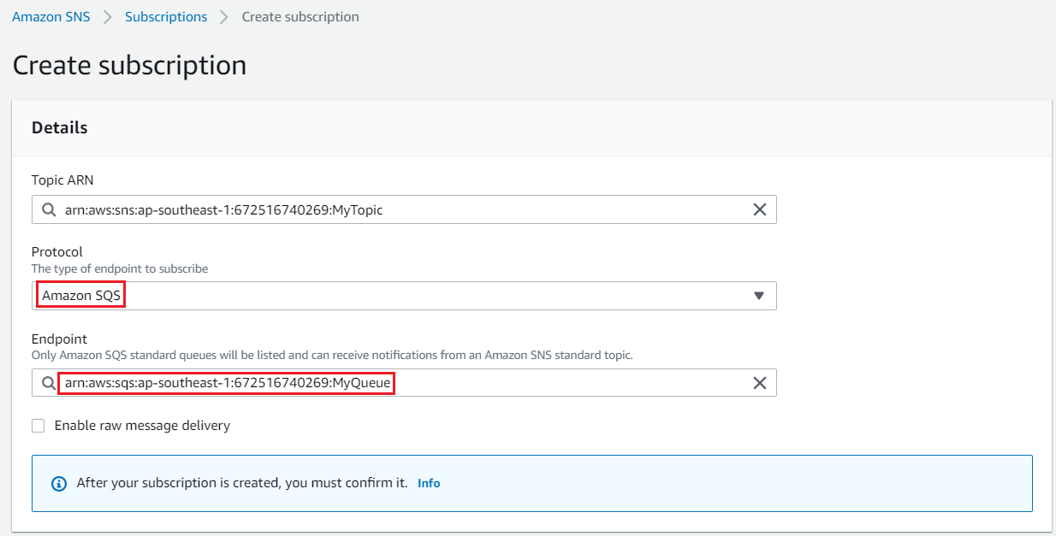
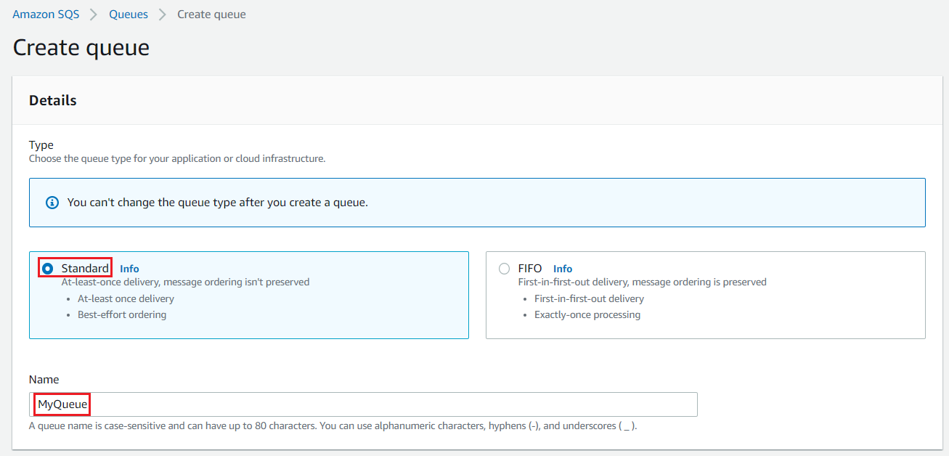
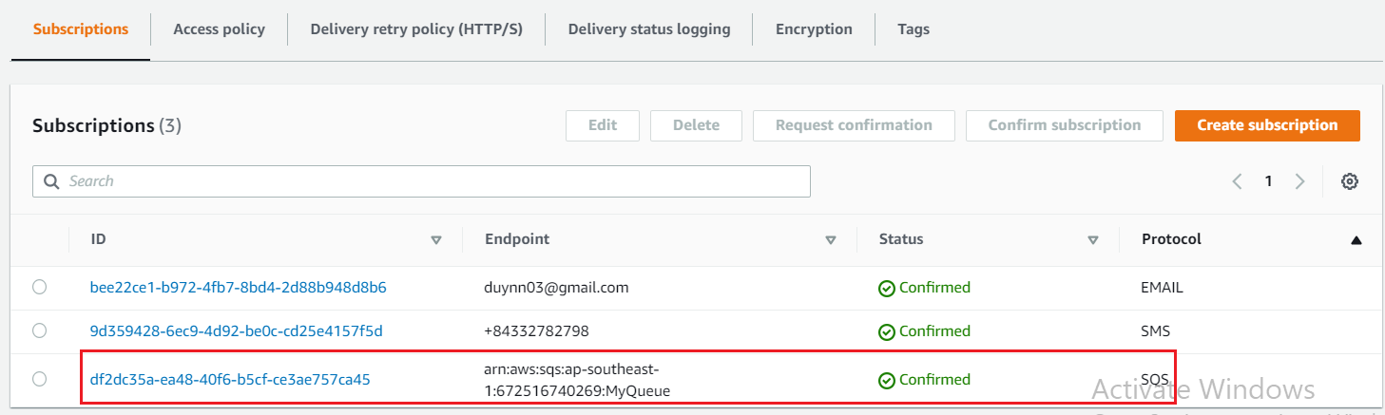
Simple Notification Service
  Create SQS Subscription
Create Queue
Create SQS Subscription

Slide 11
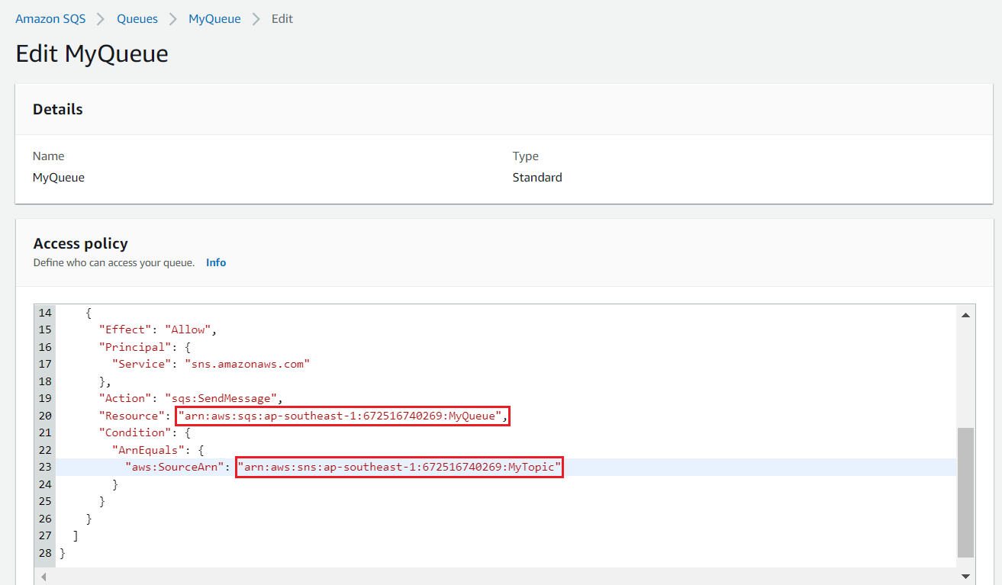
Simple Notification Service
Edit SQS Policy

Slide 12
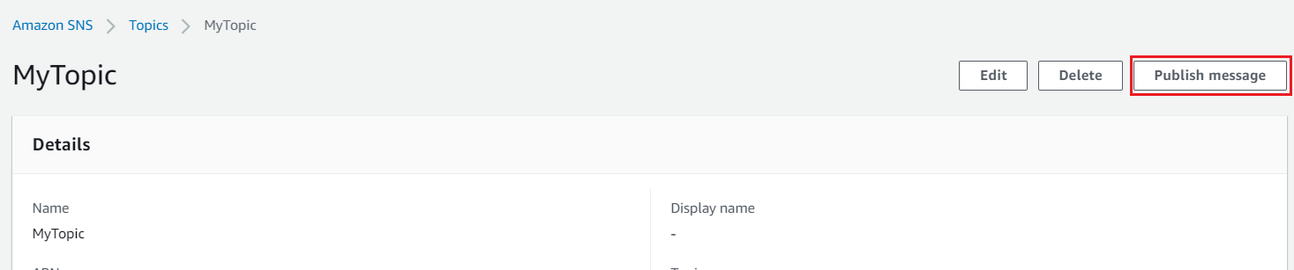
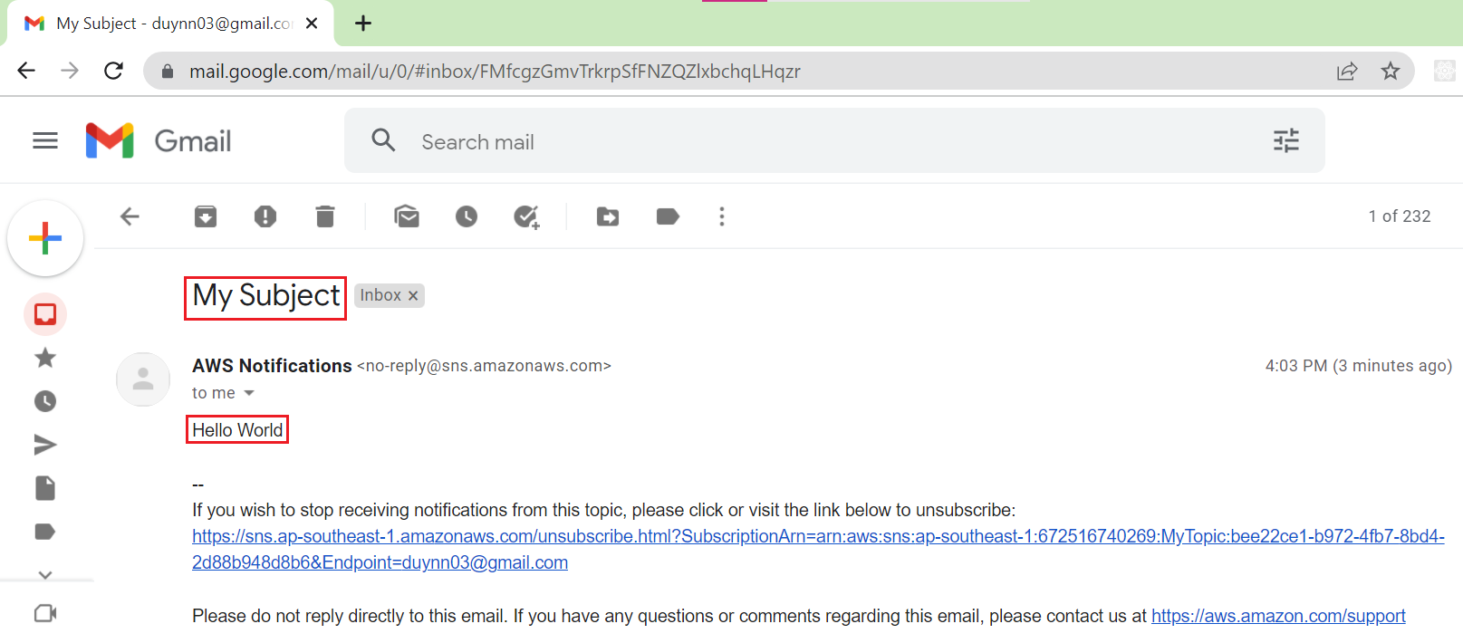
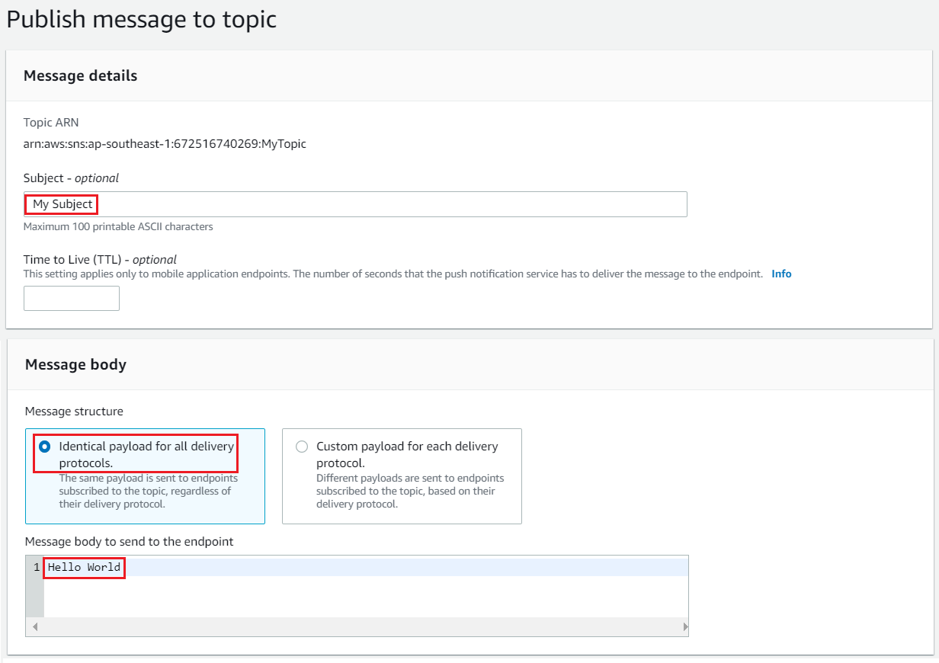
Simple Notification Service
  Test Email Subscription

Slide 13
Simple Notification Service
  Test SQS Subscription

Slide 14
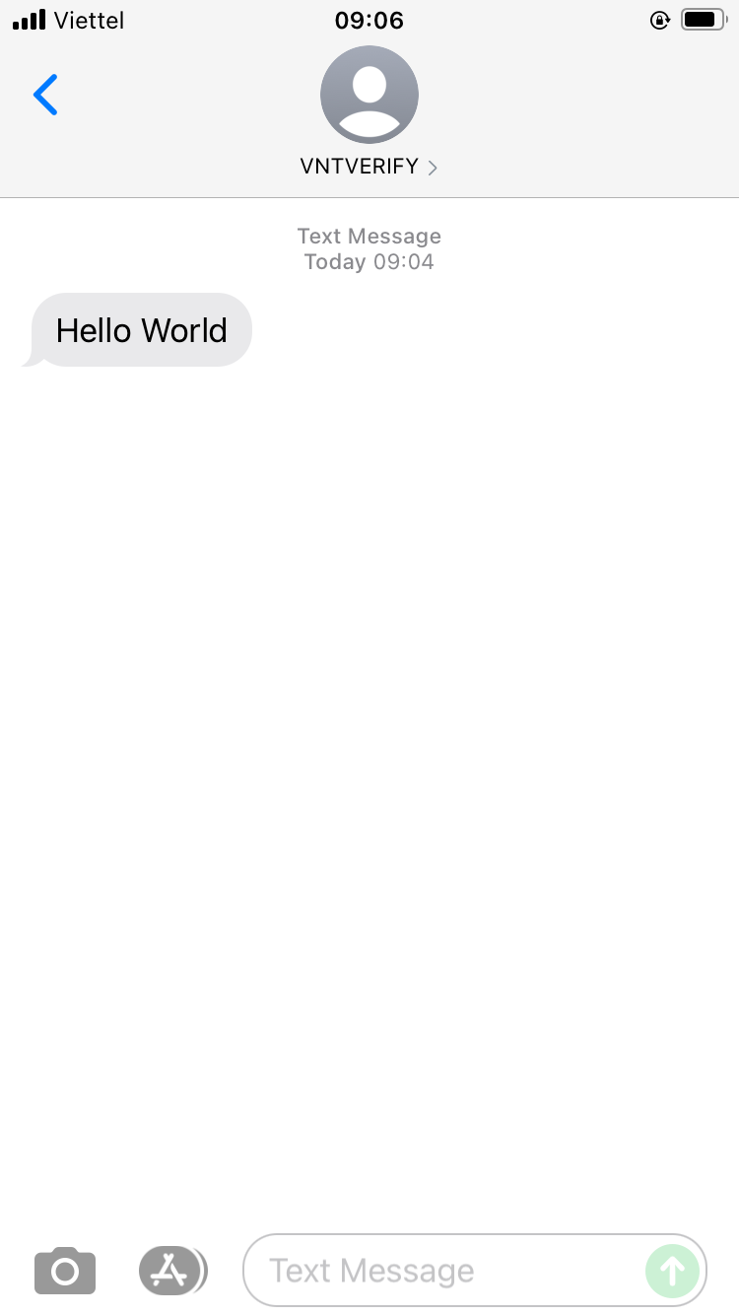
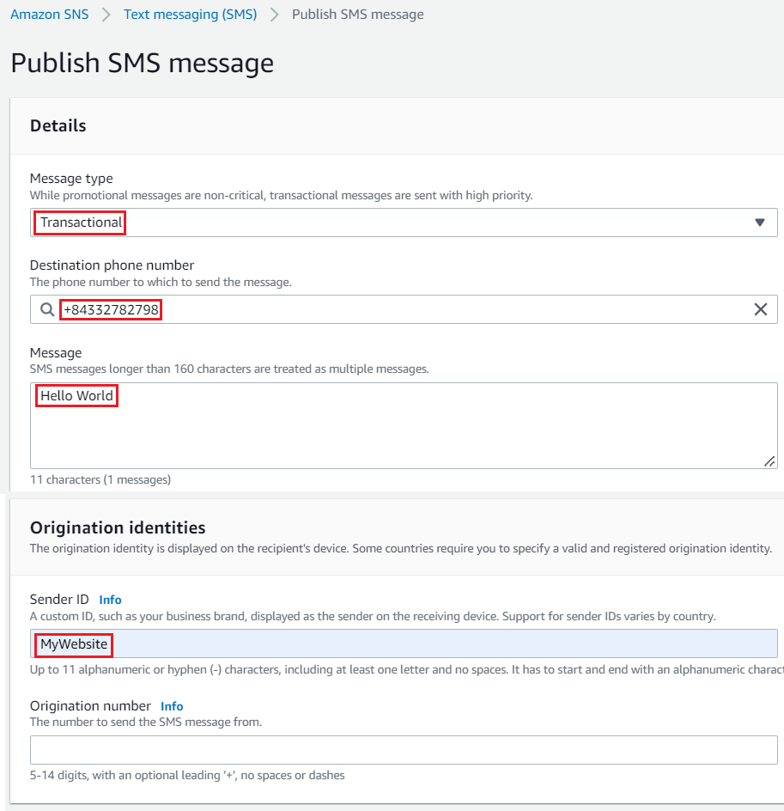
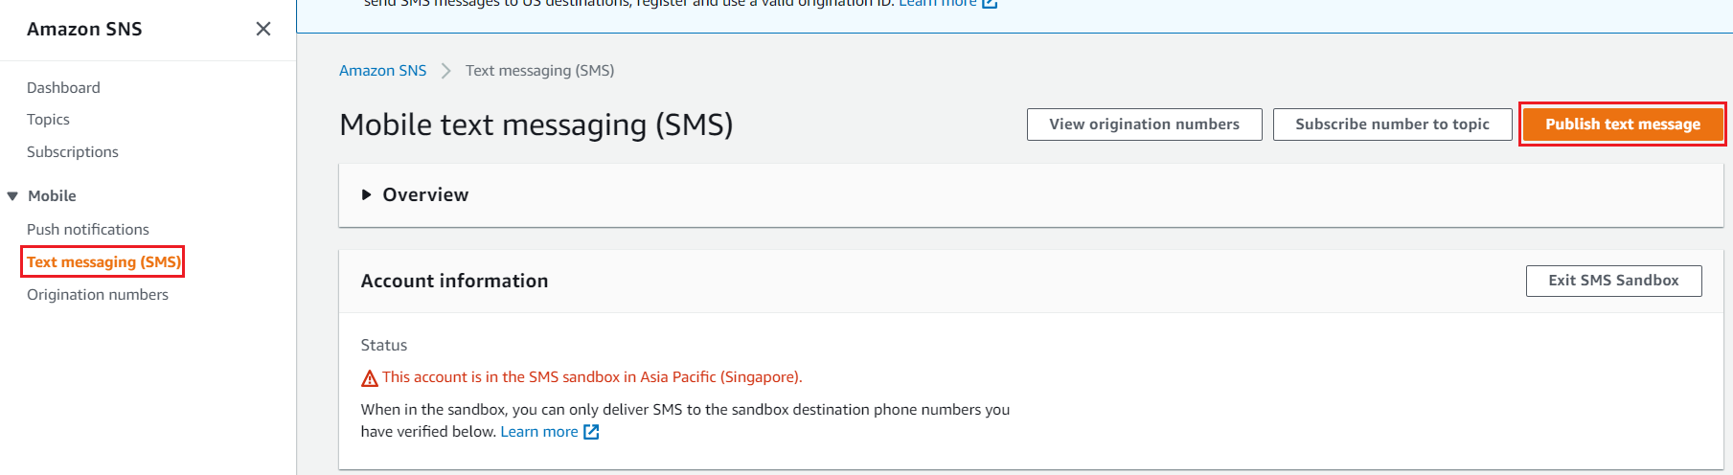
Simple Notification Service
  Test SMS Subscription

Slide 15
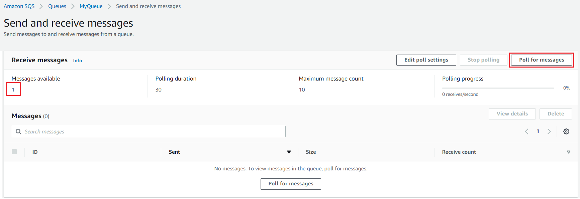
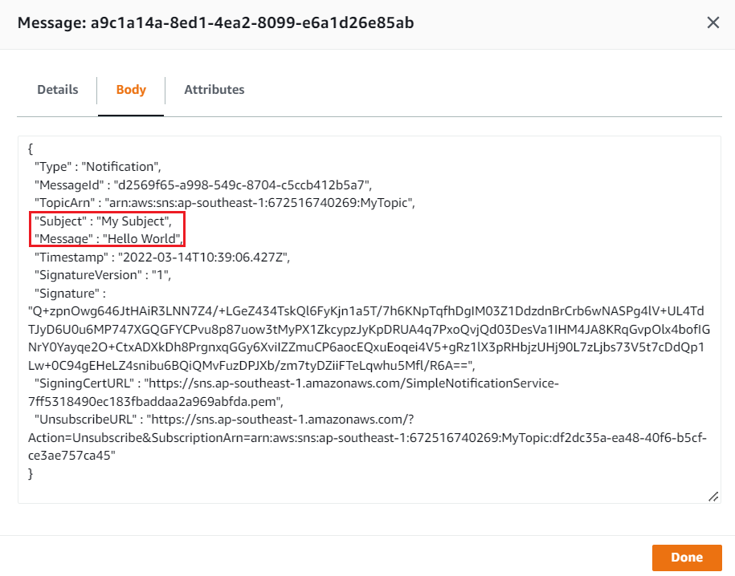
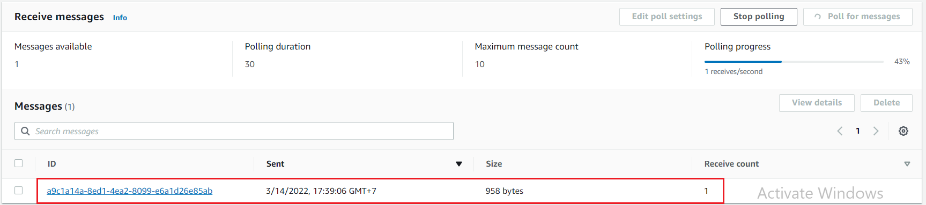
Simple Notification Service

Slide 16
Assignment
  Self-practice

Slide 17
Simple Notification Service
Components
  Subscription
  Topic

Slide 18
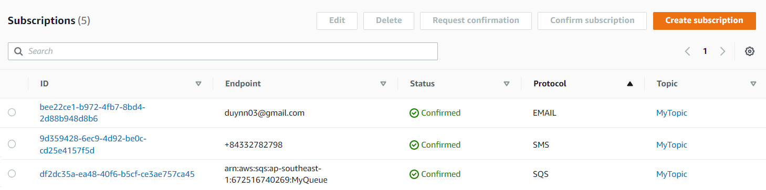
Simple Notification Service
  Subscription
    Support Email, SMS, Push Notification, SQS, Lambda, Kinesis, ...
    Up to 10,000,000 subscriptions per topic

Slide 19
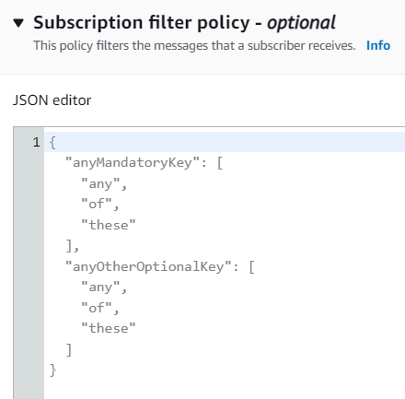
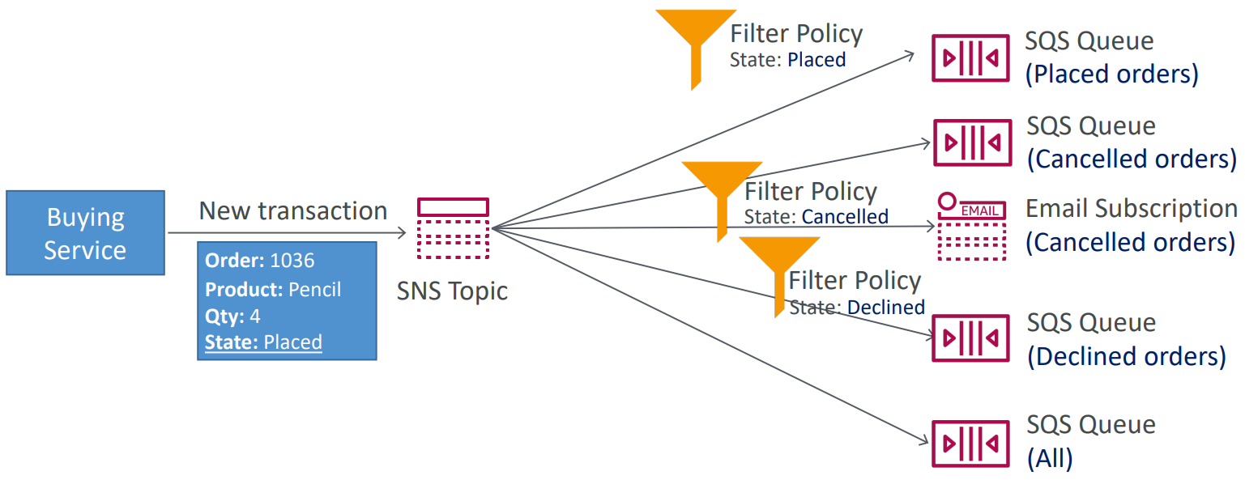
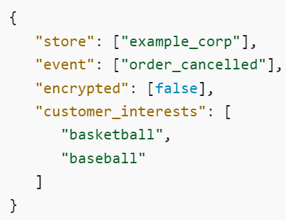
Simple Notification Service
    By default, each subscriber to the topic will get all the messages 🡺 You can filter message before sending
Tutorial: Link
Subscription filter
Tutorial: https://www.youtube.com/watch?v=huDnhvHwZx0

Slide 20
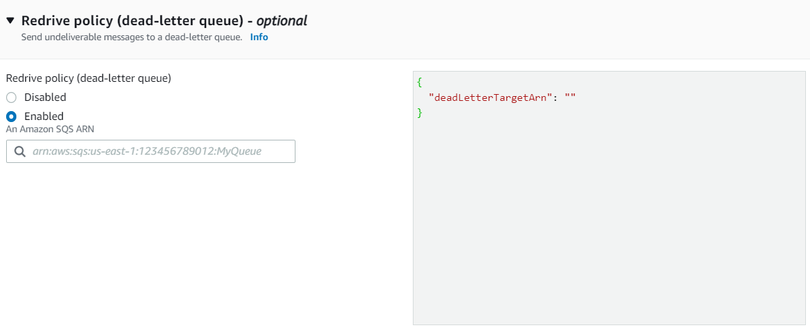
Simple Notification Service
    Dead-letter queue
      You can send undeliverable messages to a dead-letter queue (Similar to SQS Service)
Dead-letter queue

Slide 21
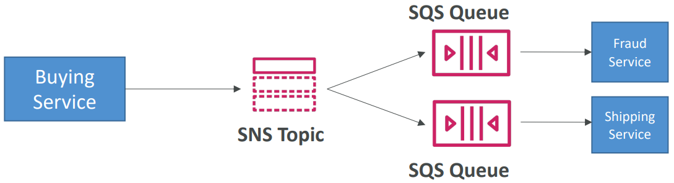
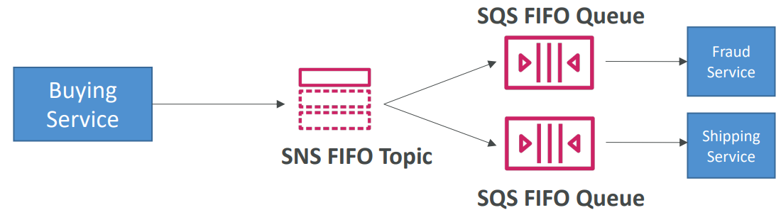
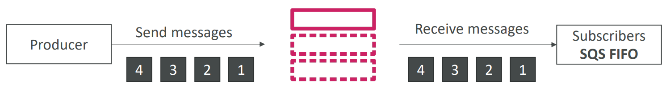
Simple Notification Service
  Topic
    Include multiple endpoints to send message (Similar to communication channel)
    100,000 topics limit
    2 types: Standard, FIFO
send message to multiple endpoints
FIFO Topic
FIFO Topic & FIFO Queue

Slide 22
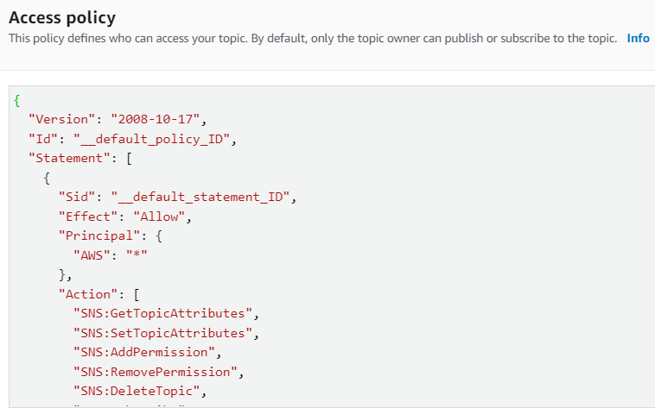
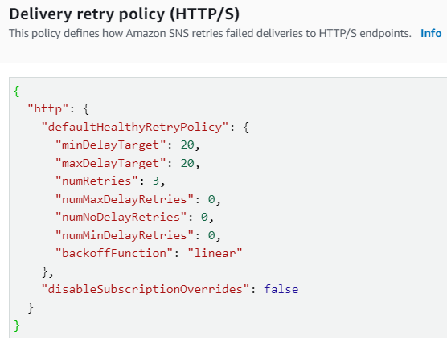
Simple Notification Service
    Access policy
      Defines who can access your topic
      By default, only the topic owner can publish or subscribe to the topic
    Delivery retry policy
      Defines how Amazon SNS retries failed deliveries
    Encryption
      In-flight encryption using HTTPS API
      At-rest encryption using KMS keys
      Client-side encryption
Access Policy
Delivery retry policy

Slide 23
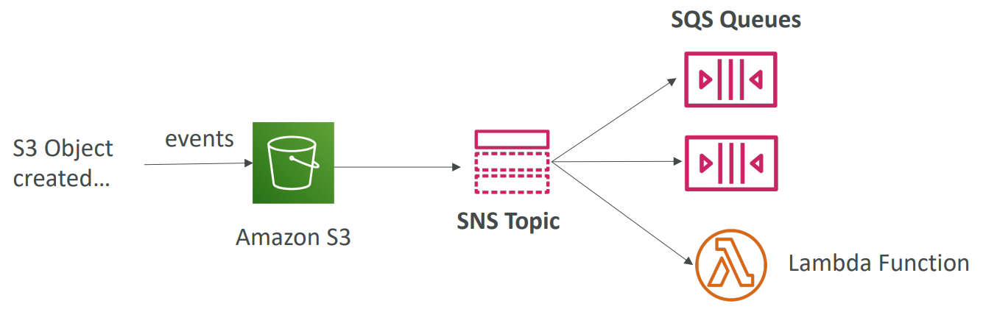
Simple Notification Service
Publish message
  You can publish message via CLI, Console, SDK (ADM, Baidu for Android, FCM, GCM, ...)
  Many AWS services can send data directly to SNS for notifications
    CloudWatch (for alarms)
    Auto Scaling Groups notifications
    Amazon S3 (on bucket events)
    ...

Slide 24
Assignment
  Self-practice

Slide 25
Summary
A service that allows you to send notifications to subscribers
Features
  Application-to-application messaging (A2A) (Ex: S3 --> SNS --> SQS)
  Application-to-person notifications (A2P) (Ex: Email, SMS, …)
Components
  Subscription
    Email, SMS, Push Notification, SQS, Lambda, Kinesis, ...
    Filter message, Dead-letter queue

Slide 26
Summary
  Topic
    2 types: Standard, FIFO
    Access policy, Delivery retry policy, Encryption
Publish message
  CLI, Console, SDK (ADM, Baidu for Android, FCM, GCM, ...)
  Many AWS services can send data directly to SNS for notifications

Slide 27
Q & A
Copyright © VTI Academy All Rights Reserved

